Slide 1
Examples

Slide 2






Workflow
Input / Event
Output / Action
API Gateway
Frontend Web App
S3
S3
AWS Lambda runs code
Cloudwatch Logs
SNS

Slide 3
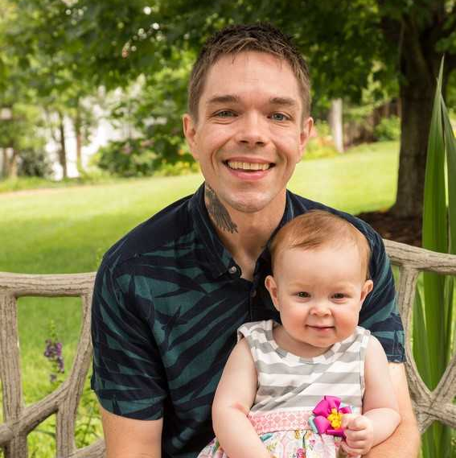

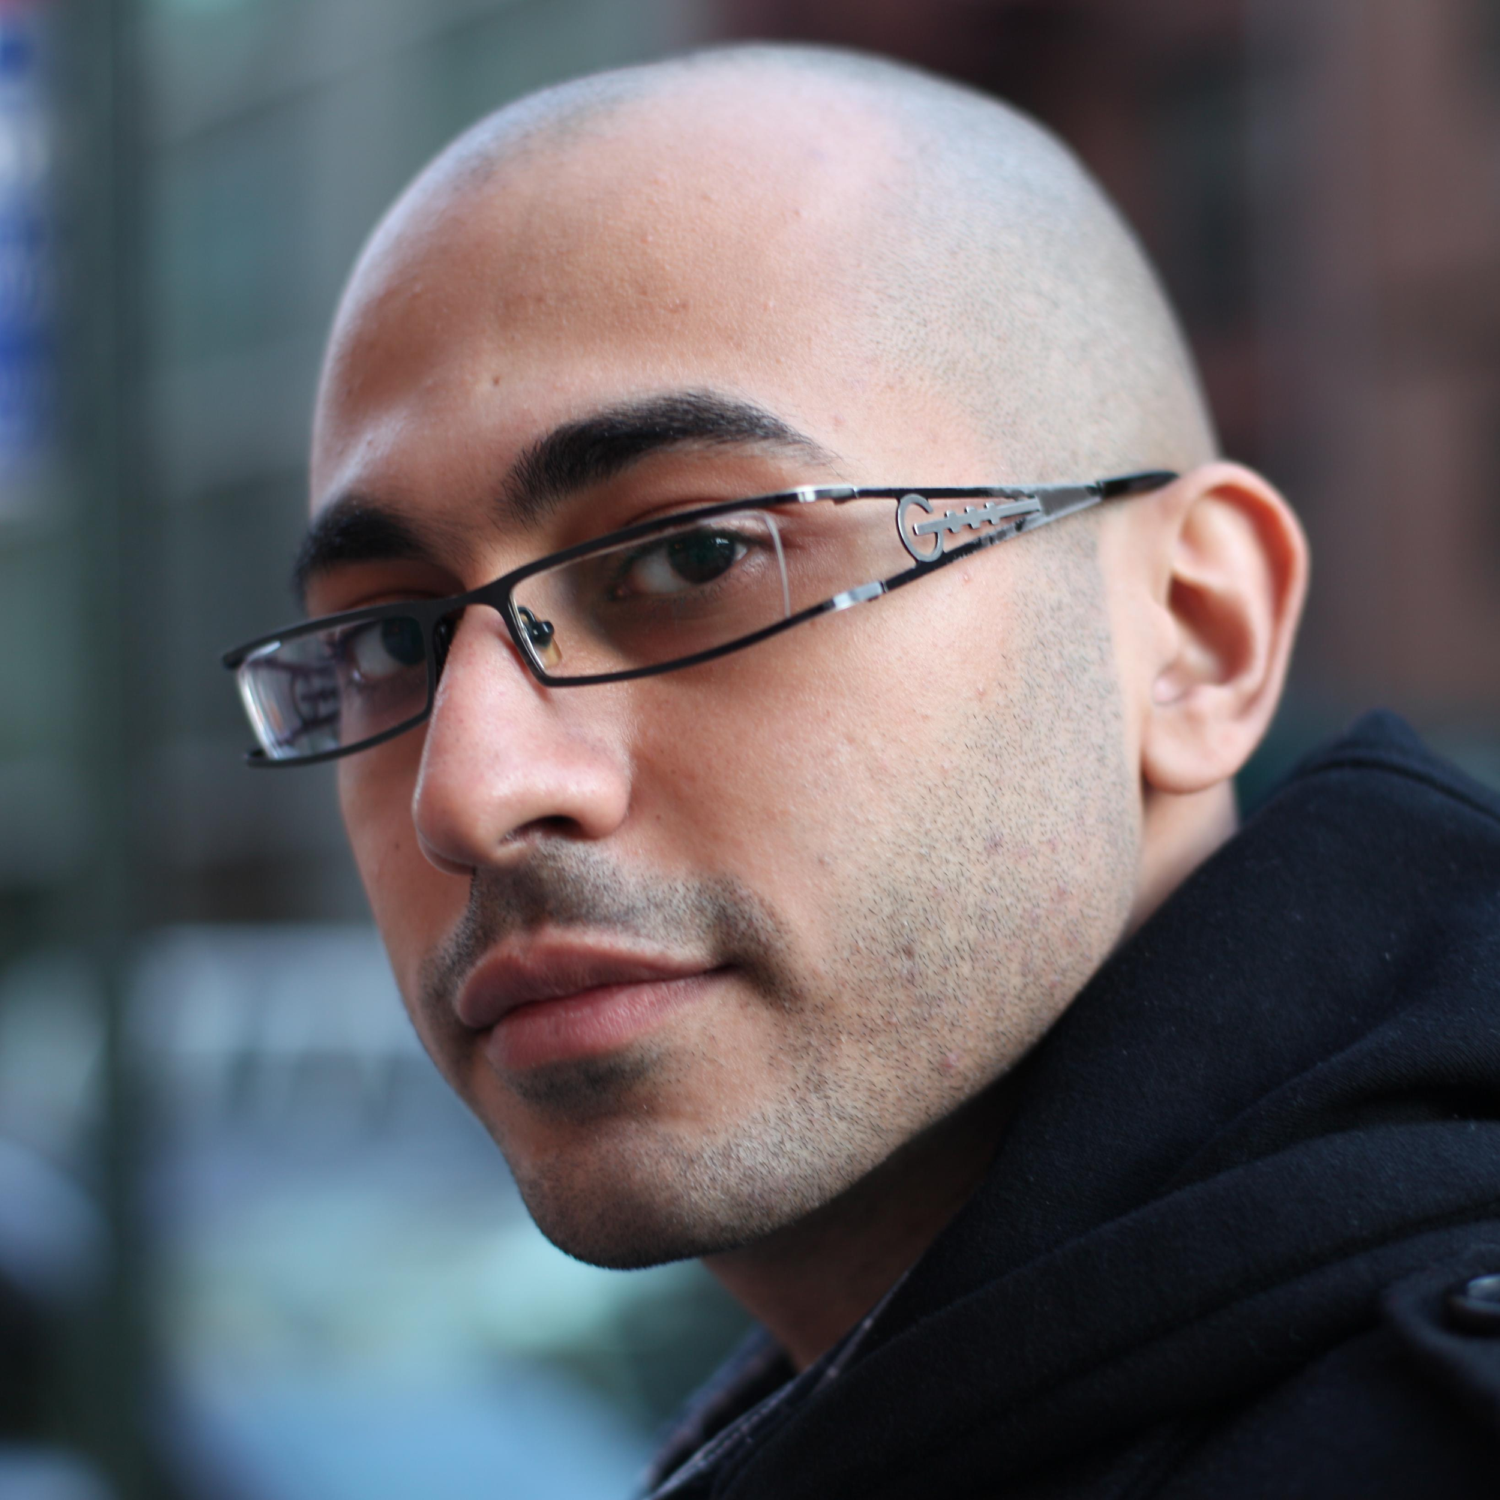
Jon Paul Lussier
Linkedin: https://www.linkedin.com/in/jonpaullussier
Email: jplussier@malwarebytes.com
Thank You
Q&A
Cameron Eckelberry
Twitter: @digitalberrybot
Linkedin: https://www.linkedin.com/in/cameck/
Email: ceckelberry@malwarebytes.com
Mina Yousseif
Linkedin: https://www.linkedin.com/in/myousseif/
Email: myousseif@malwarebytes.com

